Slide 1
OBJECT ORIENTED PROGRAMMING

Slide 2
Object oriented programming:
Concept of OOP:
Class
Object
Abstraction
Inheritance
Polymorphism
Encapsulation

Slide 3
Difference b/w OOP and POP
OOP
POP
Object oriented
Program is divided into objects
Inheritance property is used
It uses access specifier
Encapsulation is used to hide the data
Concept of virtual function
EX: C++, java
Structure oriented
Program is divided into functions
Inheritance is not allowed
It doesn’t use access specifier
No data hiding
Concept of virtual function
C, Pascal

Slide 4
Class:
It is user defined datatype.
Class is a template, It define the data member and member function.
Class is a group of object that share properties and behaviour(variable and method)
In a class can create multiple object.
Syntax:
class Classname
{
<access specifier>:
data member;
member function;
};

Slide 5
Object:
Object is a instance of class
Object is real-world entity that contain specific data or information
Object is the combination of state and behaviour
State means: variable or attributes
Behaviour means: methods or functions
Syntax:
Classname objectname1,objectname2………n;
Access the datamember and member function using (.) operator
Objectname.datamember;
Objectname.memberfunction;

Slide 6
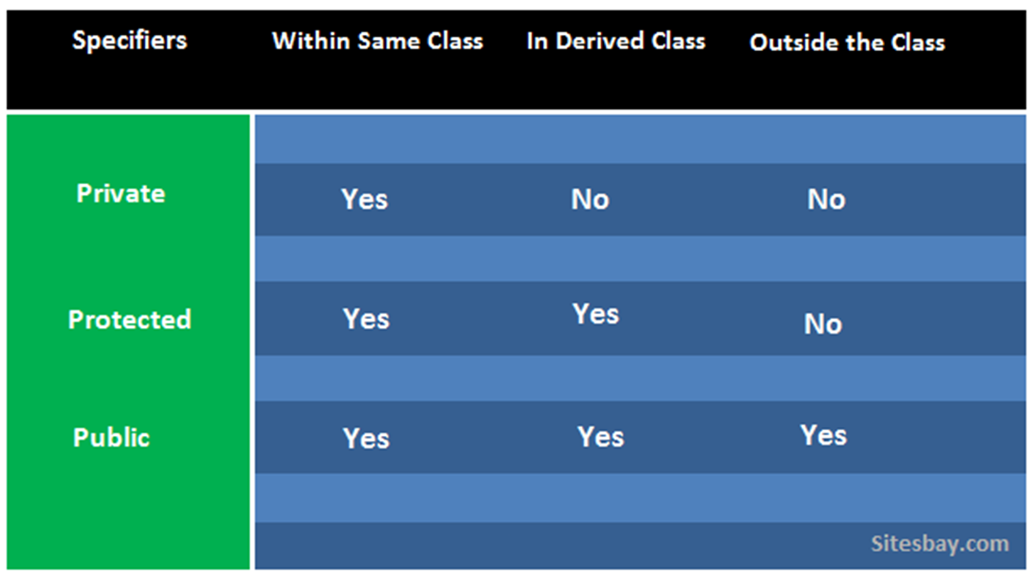
Access Specifier:

Slide 7
Program : ( example for class and object to define member function)
#include<iostream>
using namespace std;
class Display{
public:
void display(){
cout << "Hello World" << endl;
}
};
int main(){
Display d, d1;
d.display();
d1.display();
return 0;
}
Output:
Hello World
Hello World

Slide 8
Program: ( class and object to define data member )
#include<iostream>
using namespace std;
class Display{
public:
int a, b, c;
};
int main(){
Display d;
cout << "Enter two numbers" << endl;
cin >> d.a >> d.b;
d.c = d.a+d.b;
cout <<"Sum = " << d.c;
return 0;
}
Output:
Enter two numbers
3
4
Sum = 7

Slide 9
Program: ( define data member and member function)
#include<iostream>
using namespace std;
class Display{
private:
int a, b;
public:
void get(){
cout << "Enter two values : " << endl;
cin >> a >> b;
}
void put(){
cout << "A = " << a << endl;
cout << "B = " << b << endl;
cout << "Product = " << a*b;
} };
int main(){
Display d;
d.get();
d.put();
return 0;
}
Output:
Enter two values :
5
2
A = 5
B = 2
Product = 10

Slide 10
Program:( define member function outside the class )
#include<iostream>
using namespace std;
class Sample{
public:
int n;
void get();
void put();
};
void Sample::get(){
cout << "Enter the value : ";
cin >> n;
}
void Sample::put(){
cout << "N = " << n;
}
int main(){
Sample s;
s.get();
s.put();
return 0;
}
Output:
Enter the value : 100
N = 100

Slide 11
Program: ( friend function)
#include<iostream>
using namespace std;
class Stud{
private:
int no, m1, m2;
string name;
public:
void getData();
friend void showData(Stud);
};
void Stud::getData(){
cout << "Enter Name and Number : " << endl;
cin >> name >> no;
cout << "Enter marks : " << endl;
cin >> m1 >> m2;
}

Slide 12
void showData(Stud s){
cout << "Name : " << s.name << endl;
cout << "No : " << s.no << endl;
cout << "Mark 1 : " << s.m1 << endl;
cout << "Mark 2 : " << s.m2 << endl;
}
int main(){
Stud s1;
s1.getData();
showData(s1);
return 0;
}
Output:
Enter Name and Number :
Anu 40
Enter marks :
98 99
Name : Anu
No : 40
Mark 1 : 98
Mark 2 : 99

Slide 13
Program : ( friend class )
#include<iostream>
using namespace std;
class Emp{
int eno;
string name;
private:
friend class sal;
};
class sal{
int sal;
public:
Emp d;
void input(){
cout << "Enter the Emp no : ";
cin >> d.eno;
cout << "Enter Emp name ";
cin >> d.name;
cout << "Enter Emp salary";
cin >> sal;
}
void output(){
cout << "Emp no : " << d.eno << endl;
cout << "Emp name : " << d.name << endl;
cout << "Emp salary : " << sal << endl;
}
};

Slide 14
int main(){
sal s;
s.input();
s.output();
return 0;
}
Output:
Enter the Emp no : 1
Enter Emp name : Anu
Enter Emp salary : 50000
Emp no : 1
Emp name : Anu
Emp salary : 50000

